Slide 1

DESIGN OF GANTRY LOADER MILLING MACHINE (GLMM)
BATCH - 09

Slide 2
TEAM MEMBERS
Abishek T (99008003)
Mohanapriya M S (99008004)
Jeeva Narayanasamy (99008005)
Jeya Suriya K (99008006)
Atit Pokle (99007950)
Vinod Patil (99007951)

Slide 3
PROBLEM STATEMENT
It is required to design a gantry loader system for CNC milling machine for picking the workpiece from a specified location and place it on the milling machine table/vice. The weight carrying capacity of the loader should be minimum 3 kg. A vertical lift of 1500 mm, horizontal travel of 1000 mm is essential in the working envelope. We are required to design the mechanism for picking the workpiece from the pick up location and transfer it to the work table. The design should clearly provide the mechanism implemented, design calculations for strength/dimensions for each link/component and justify selection of any off-the-shelf component like bolts, bearings, bushes, motors, couplings etc. Also we can select the gripper/end effector of our choice but we need to clearly specify its features and limitations.

Slide 4
DESIGN SELECTION
CONCEPT - I :
The design concept - I for the given problem statement involves a frame and sliding plate as major components of the system. Sliding plate will be supported by the frame in such a way so that the plate will we be easily slides under required force in axial direction. Basically this slider carries the pneumatic actuator with adaptive gripper as end effector to load the work piece. A high torque motor will be used to drive the end effector for loading and unloading.The required force to move the sliding plate will be given by a combination of gear systems, where a rack and pinion setup is axially coupled with spur gears to achieve the movement of required distance. The end of the rack that is used to move the plate will be welded or attached with the sliding plate to achieve push and pull.

Slide 5
DESIGN SELECTION
CONCEPT - II :
The design concept - II for GLMM is almost similar to the working of concept - I, where a sliding plate is supported by frame also it carries a pneumatic actuators with adaptive grippers to load and unload the work piece. The main difference between both concepts is the source of push and pull force . In this concept, another pneumatic actuator is employed to make the required sliding motion of plate instead of gear systems. The rack that is required to make contact with sliding plate will be replaced by the piston rod of the actuator.

Slide 6
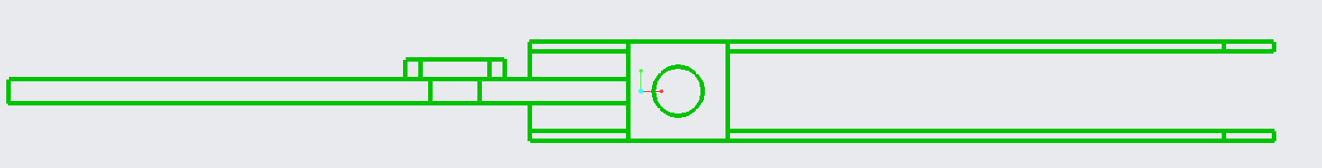
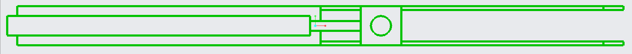
DESIGN SELECTION
CONCEPT SKETCH - I
CONCEPT SKETCH - II

Slide 7
SELECTION OF DESIGN
FINAL DESIGN CONCEPT :
We have selected the design concept - II to address the problem statement due to following reasons :
Actuators are more reliable than gear drives, because of their flexibility.
Gear drives make system more complex, however actuators make system compact.
When the workpiece exceeds the minimum load, then there will be a possibility of vibrations, noise and collapse of the gear drives ( under cost cutting factor ).
Less maintenance required in actuators than gear drives.

Slide 8
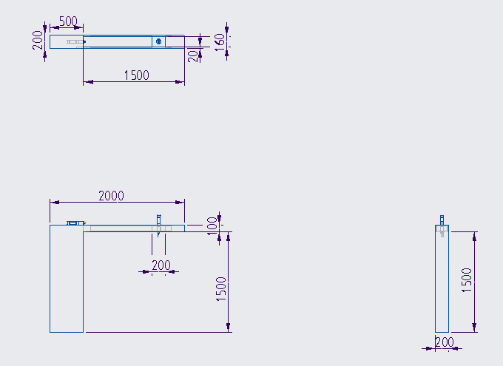
ORTHOGRAPHIC VIEW
.

Slide 9
MATERIAL SELECTION
Material of the sliding plate that carries actuator along with gripper in unloaded condition and actuator along with gripper holding job of minimum 3kg weight in loaded condition, requires reasonable ductile property to make an axial movement by withholding all the load. Mild steel is a desired material for this application since it has good ductility to withstand tension.
The frame of the GLMM that carries the actuator system along with sliding plate of respectable amount of weight, should also able to withstand over all tension and bending. Since mild steel is good with withstanding tension by having reasonable yield strength and its nature of machinability and weldability makes it suitable for body frame of GLMM.

Slide 10
DESIGN CALCULATIONS

Slide 11
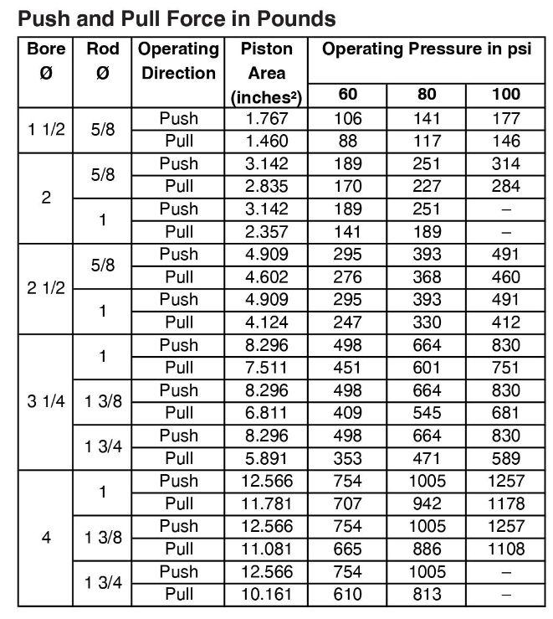
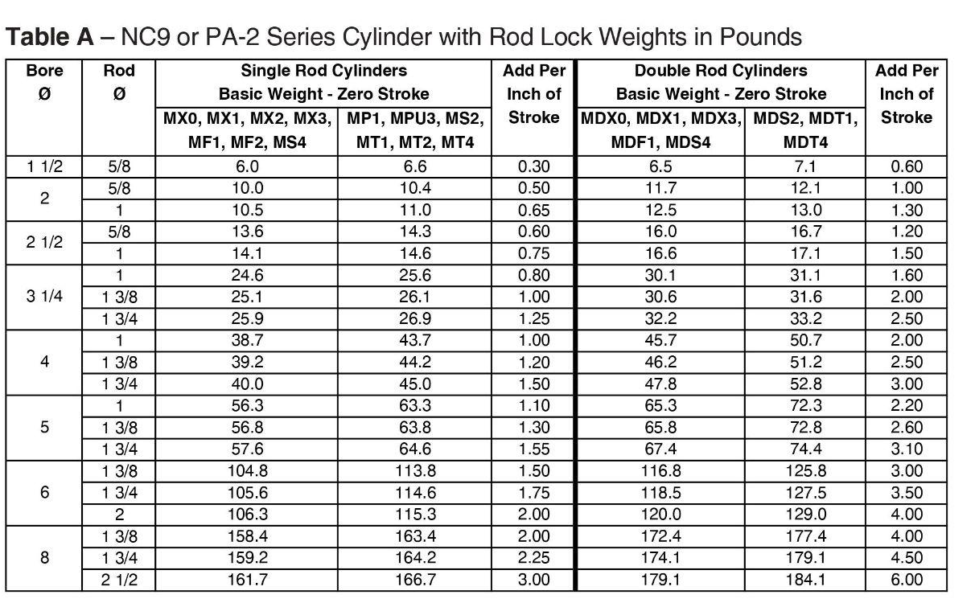
CATALOGUE DATA FOR ACTUATOR

Slide 12
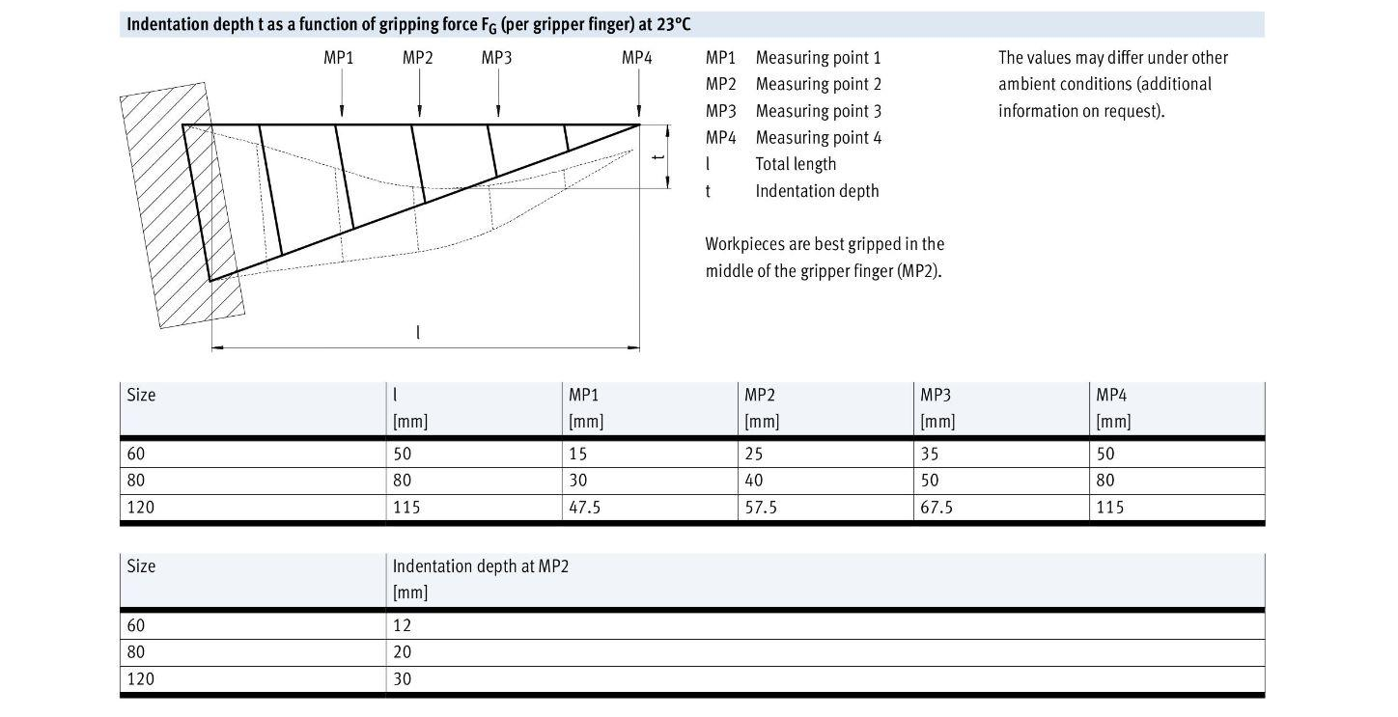
CATALOGUE DATA FOR GRIPPER

Slide 13
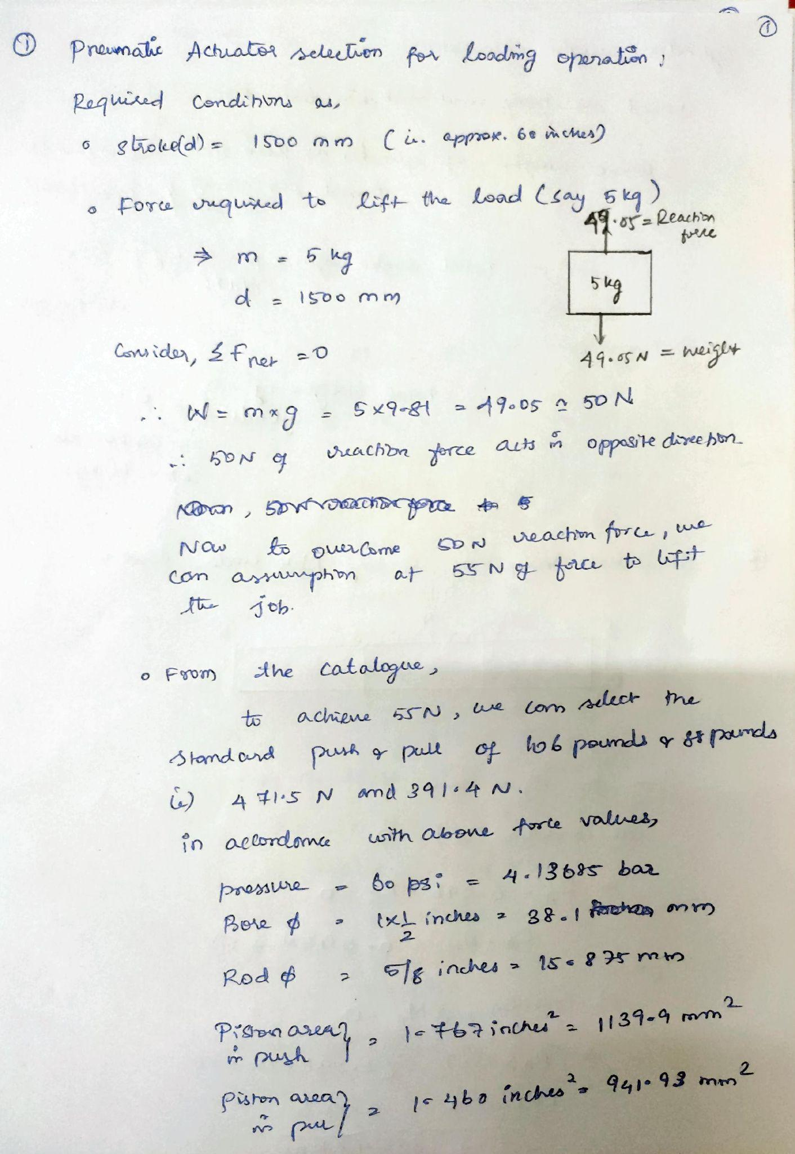
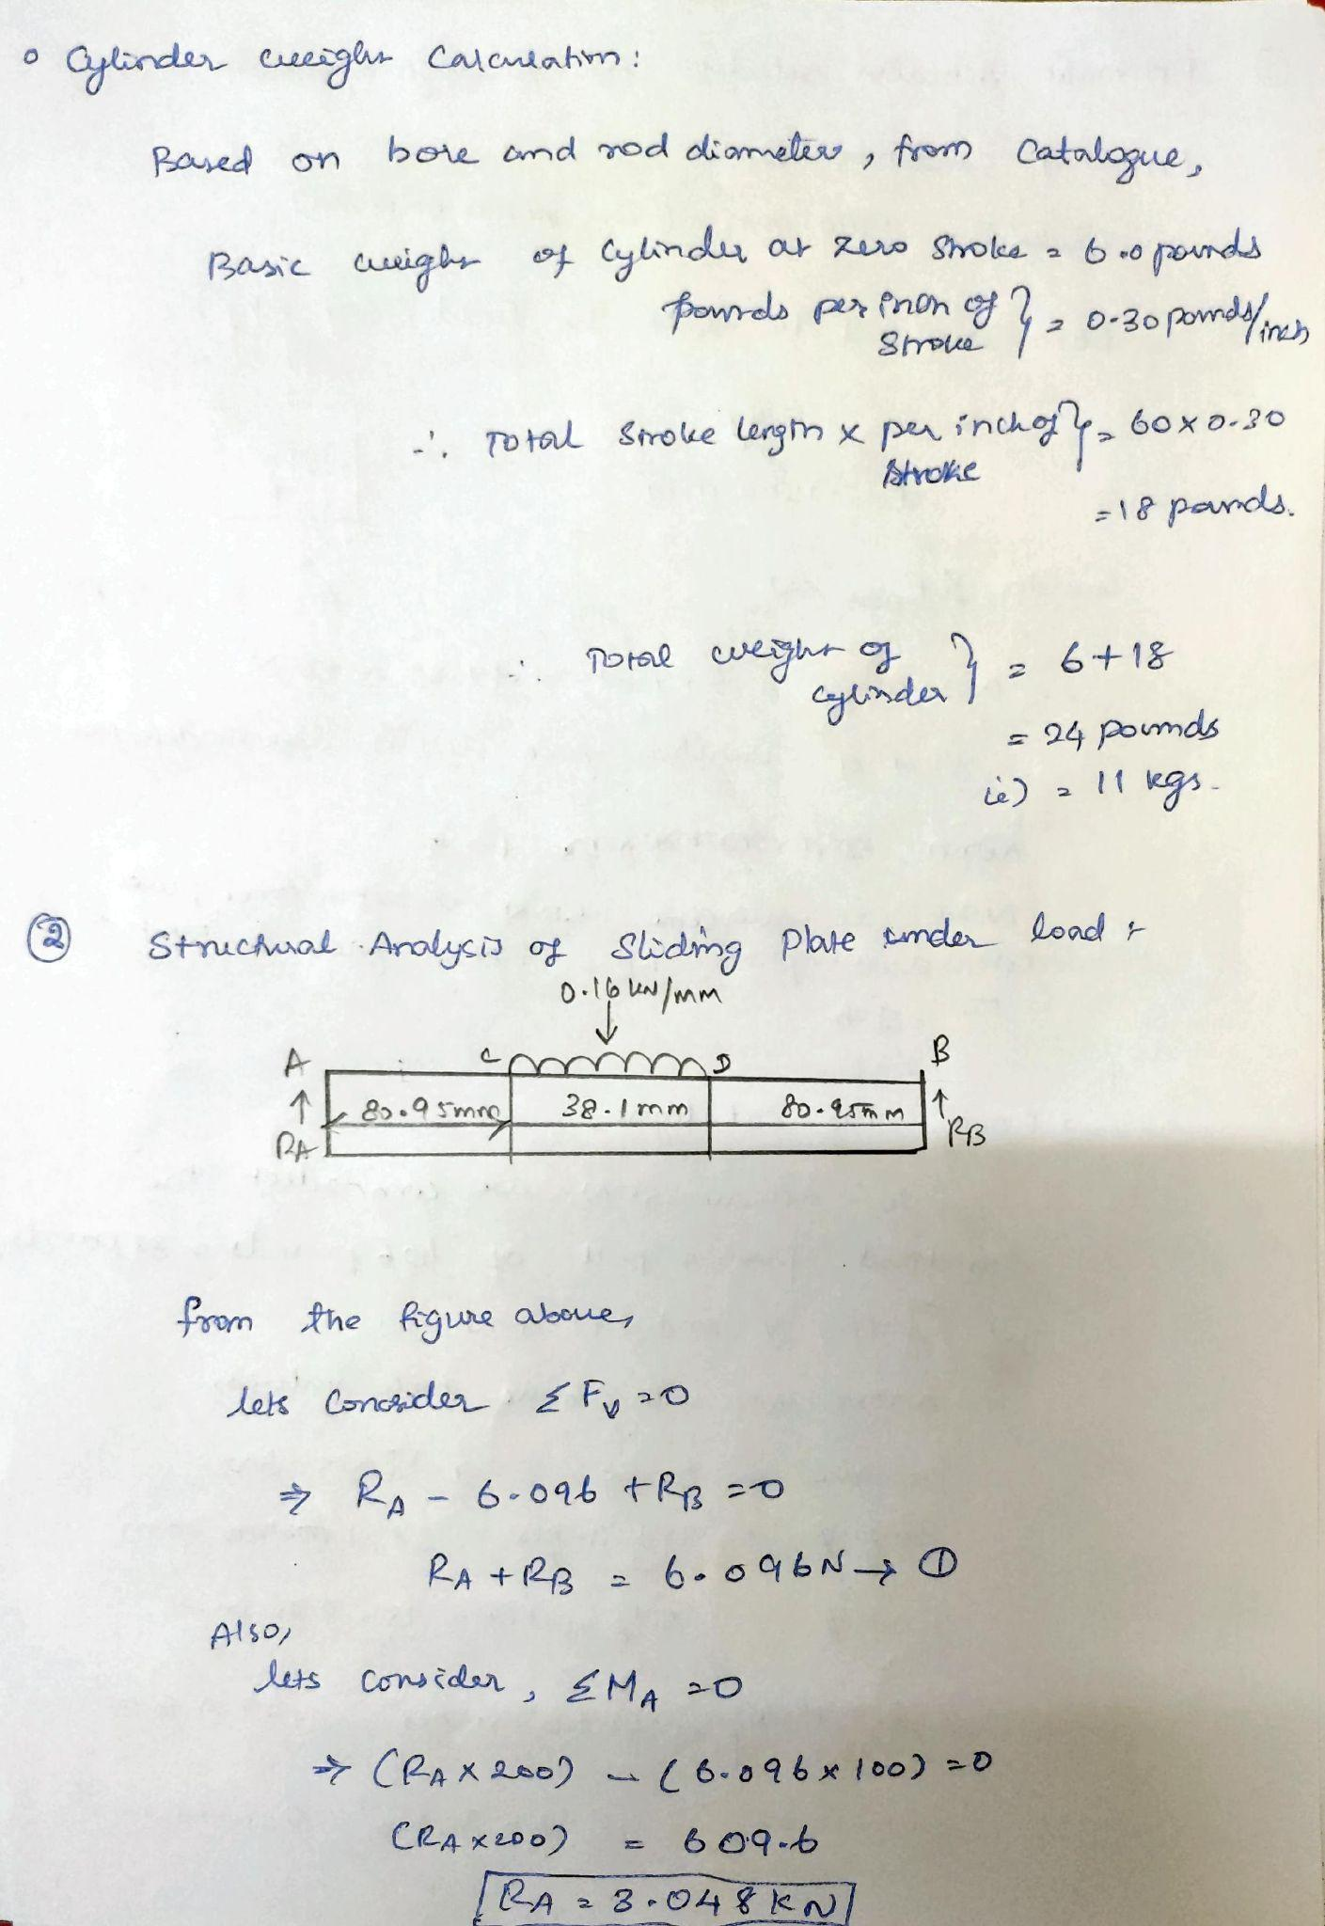

Slide 14
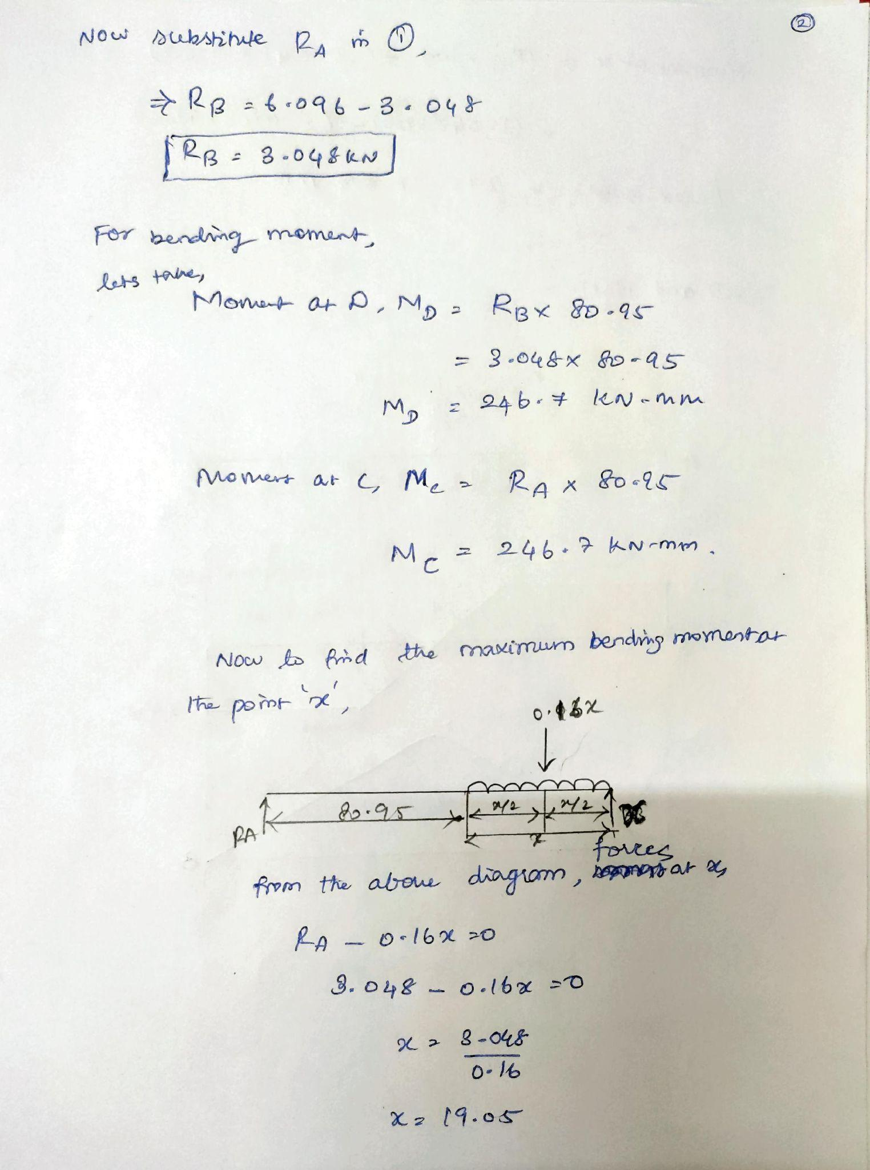
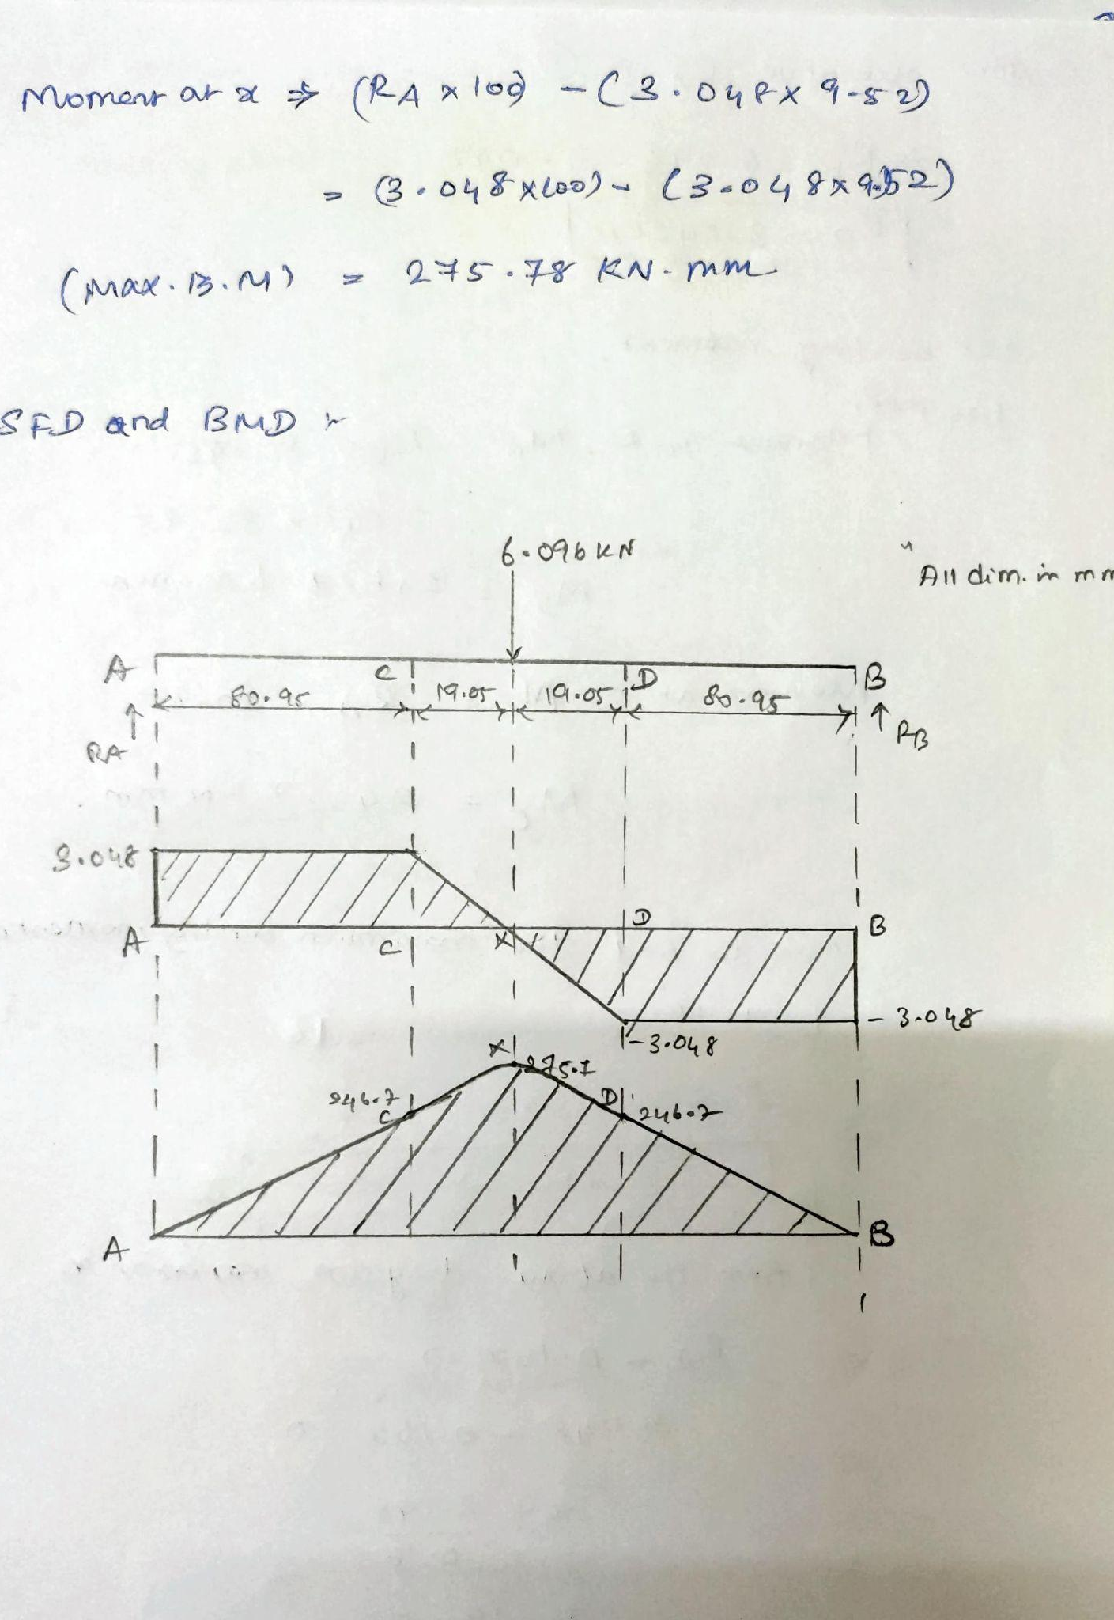

Slide 15
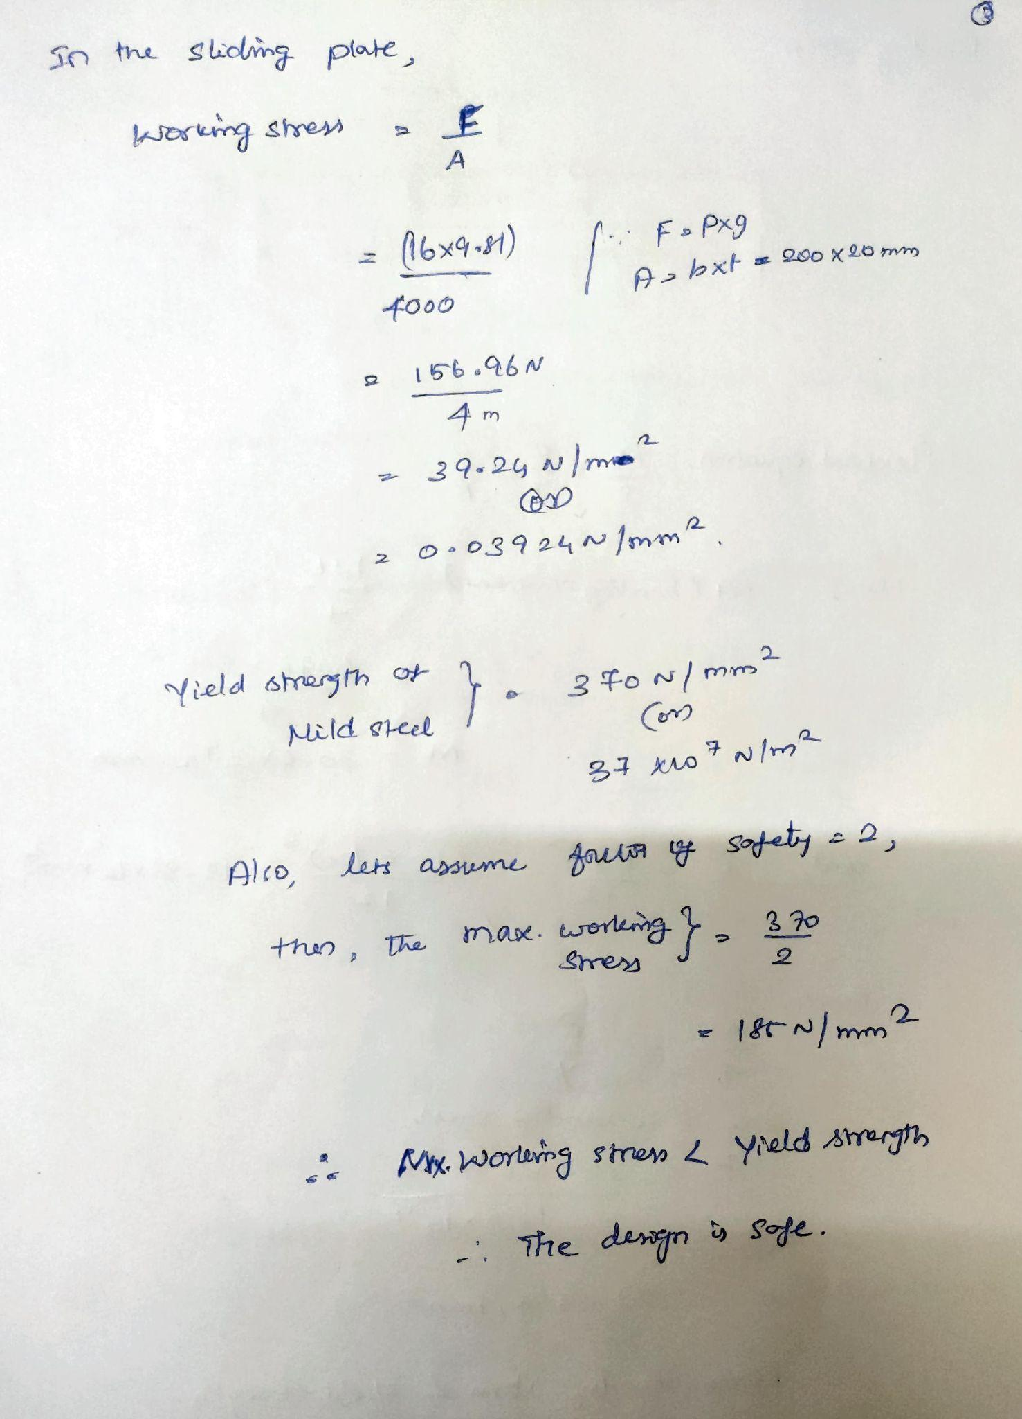
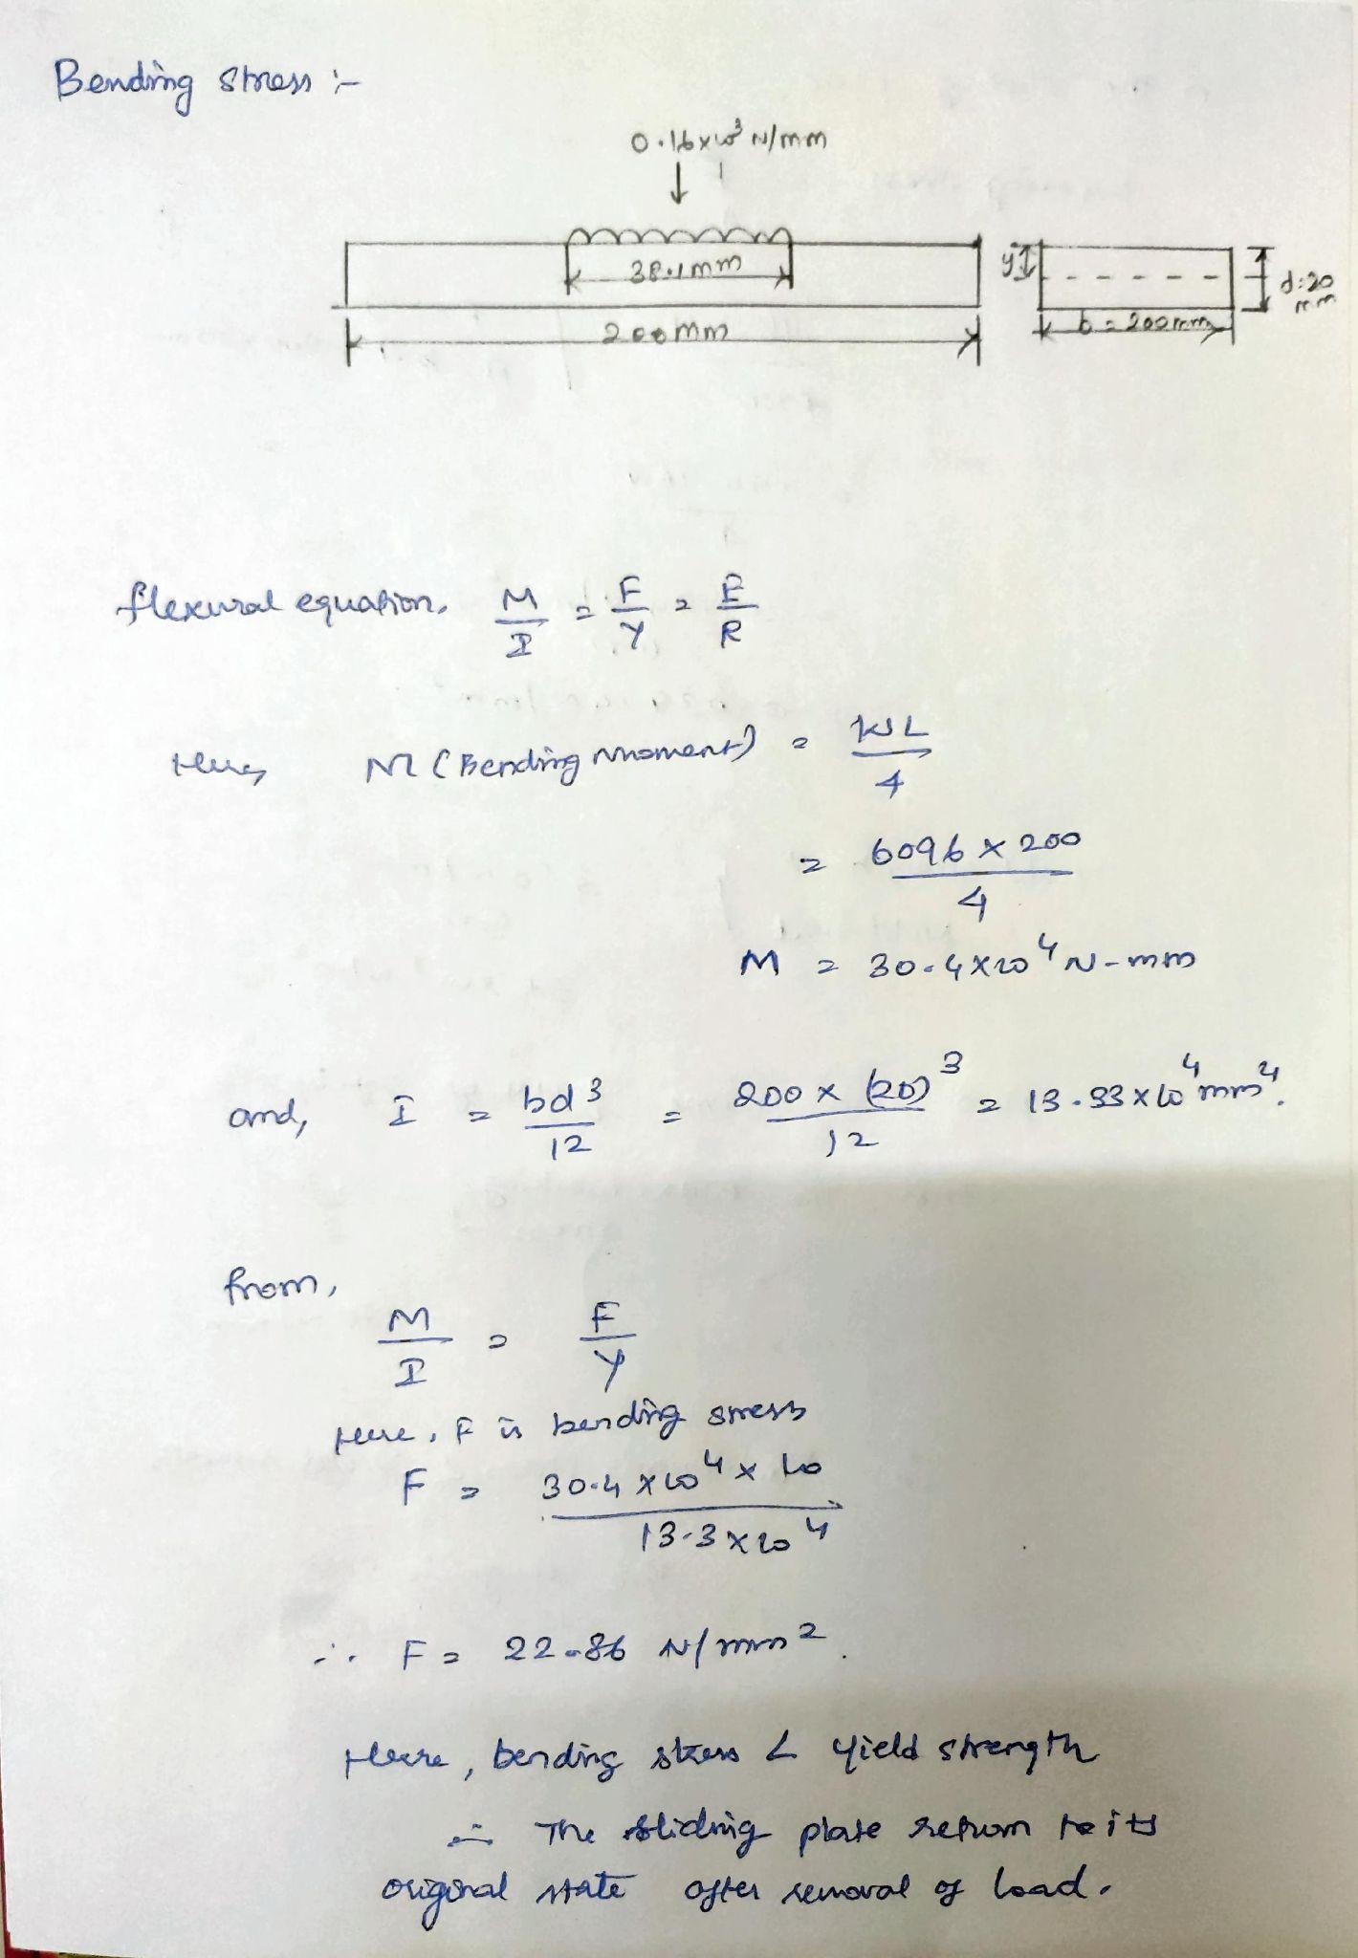

Slide 16
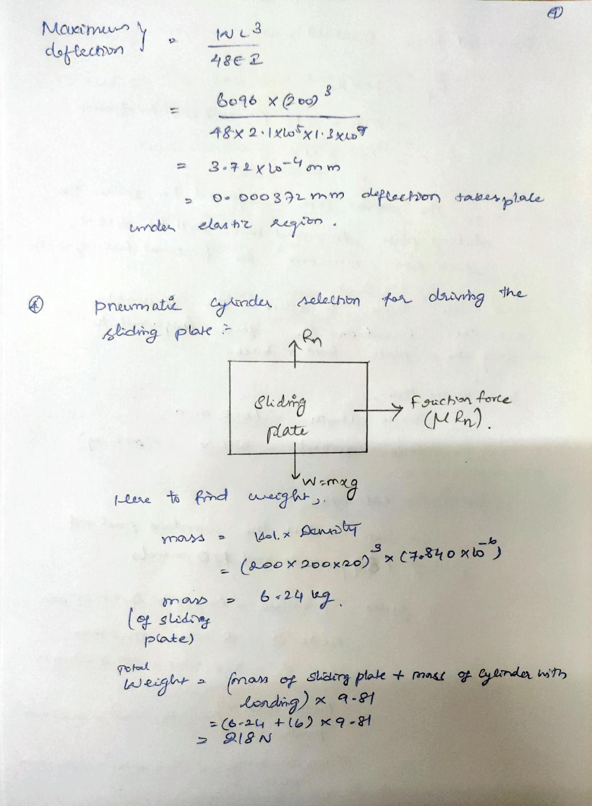
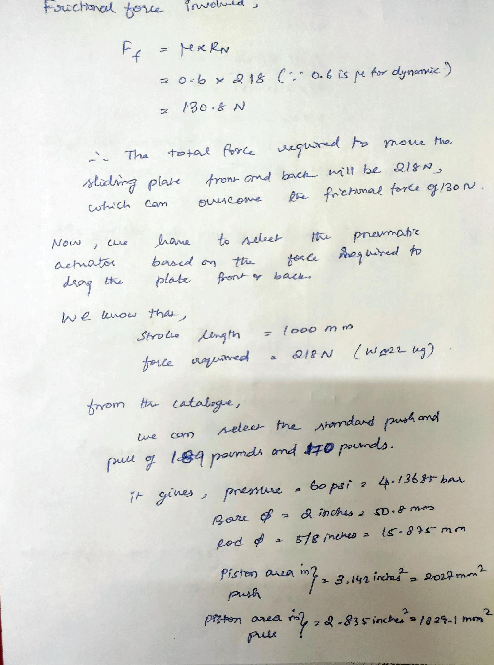

Slide 17
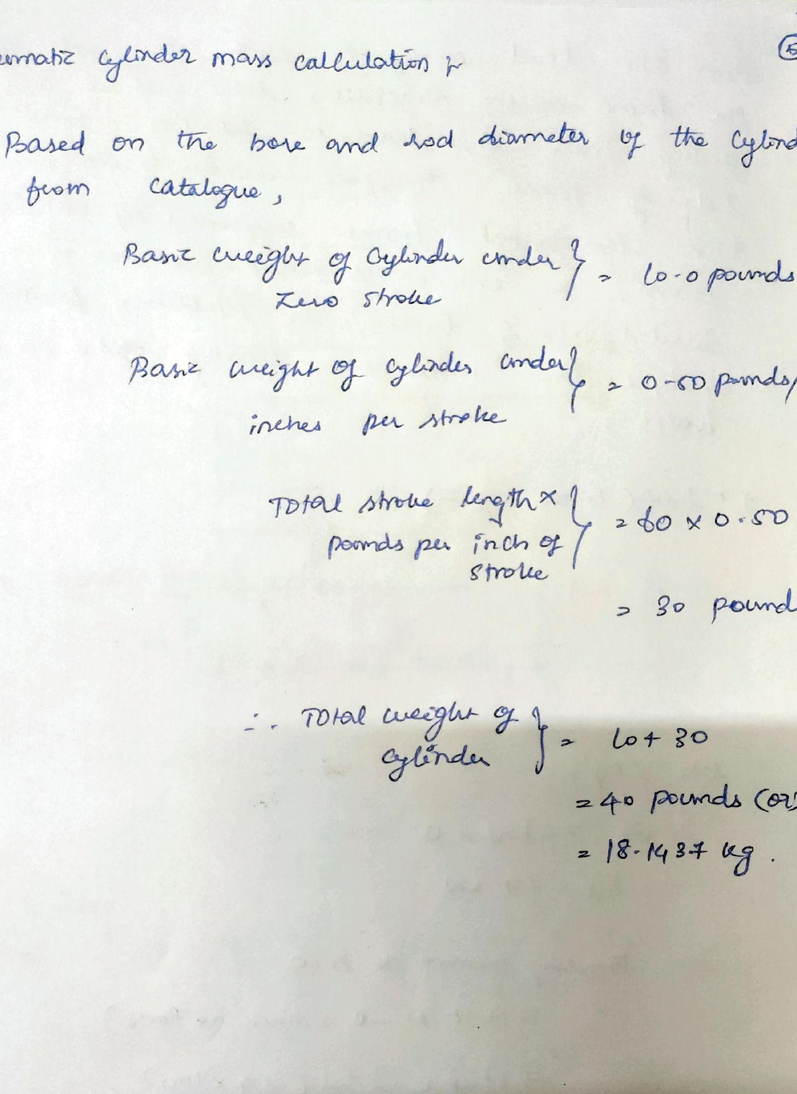
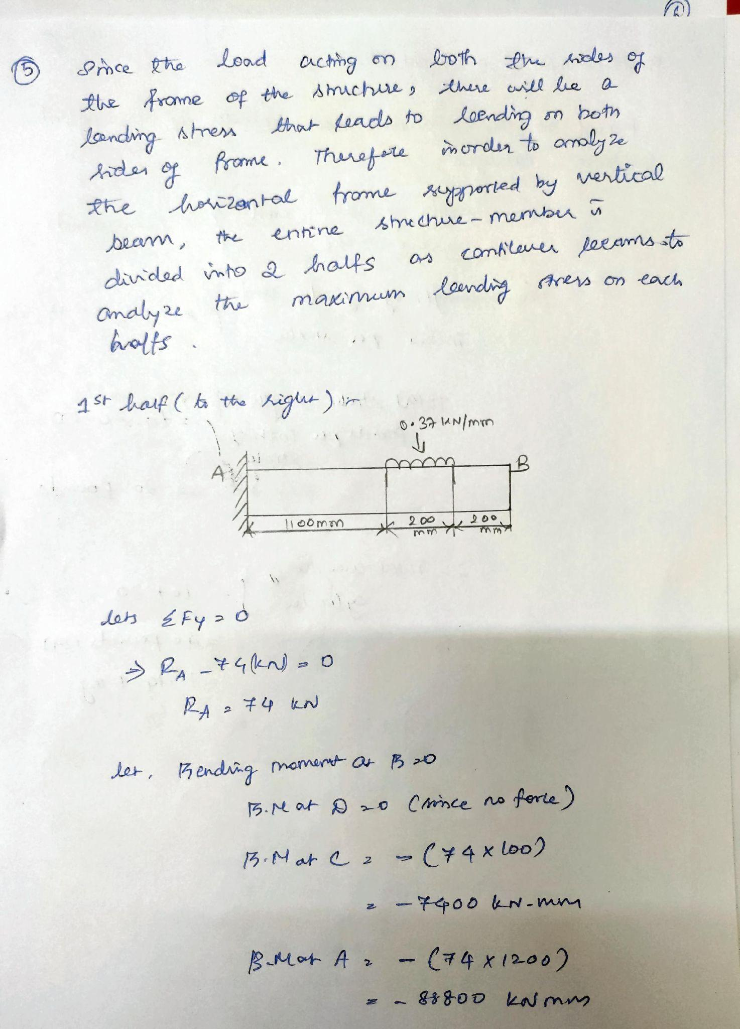

Slide 18
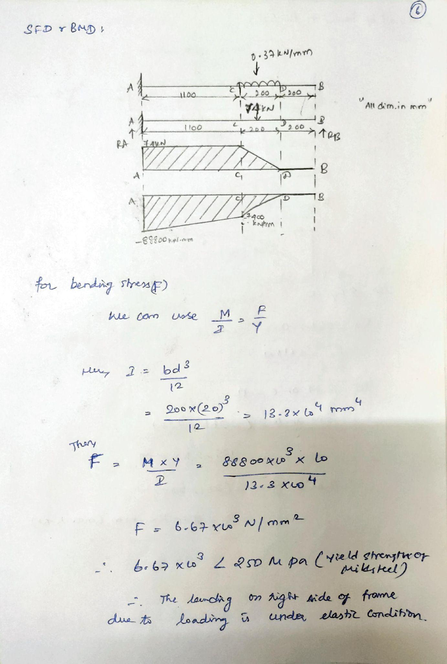

Slide 19
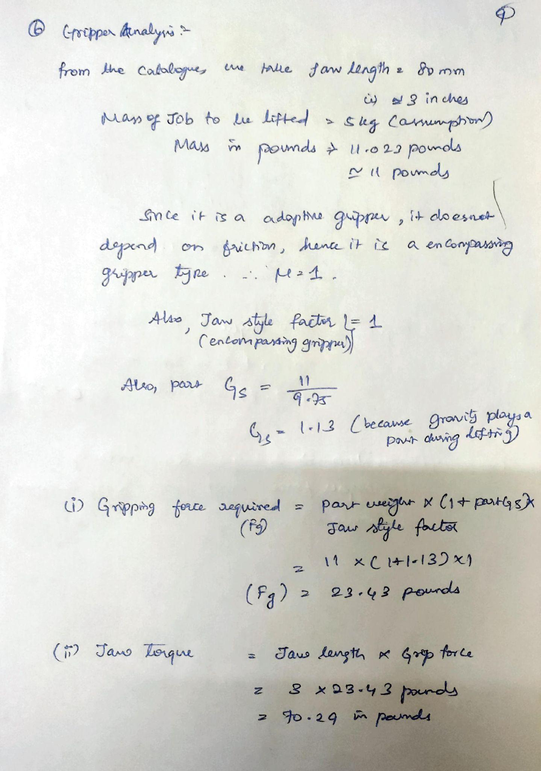
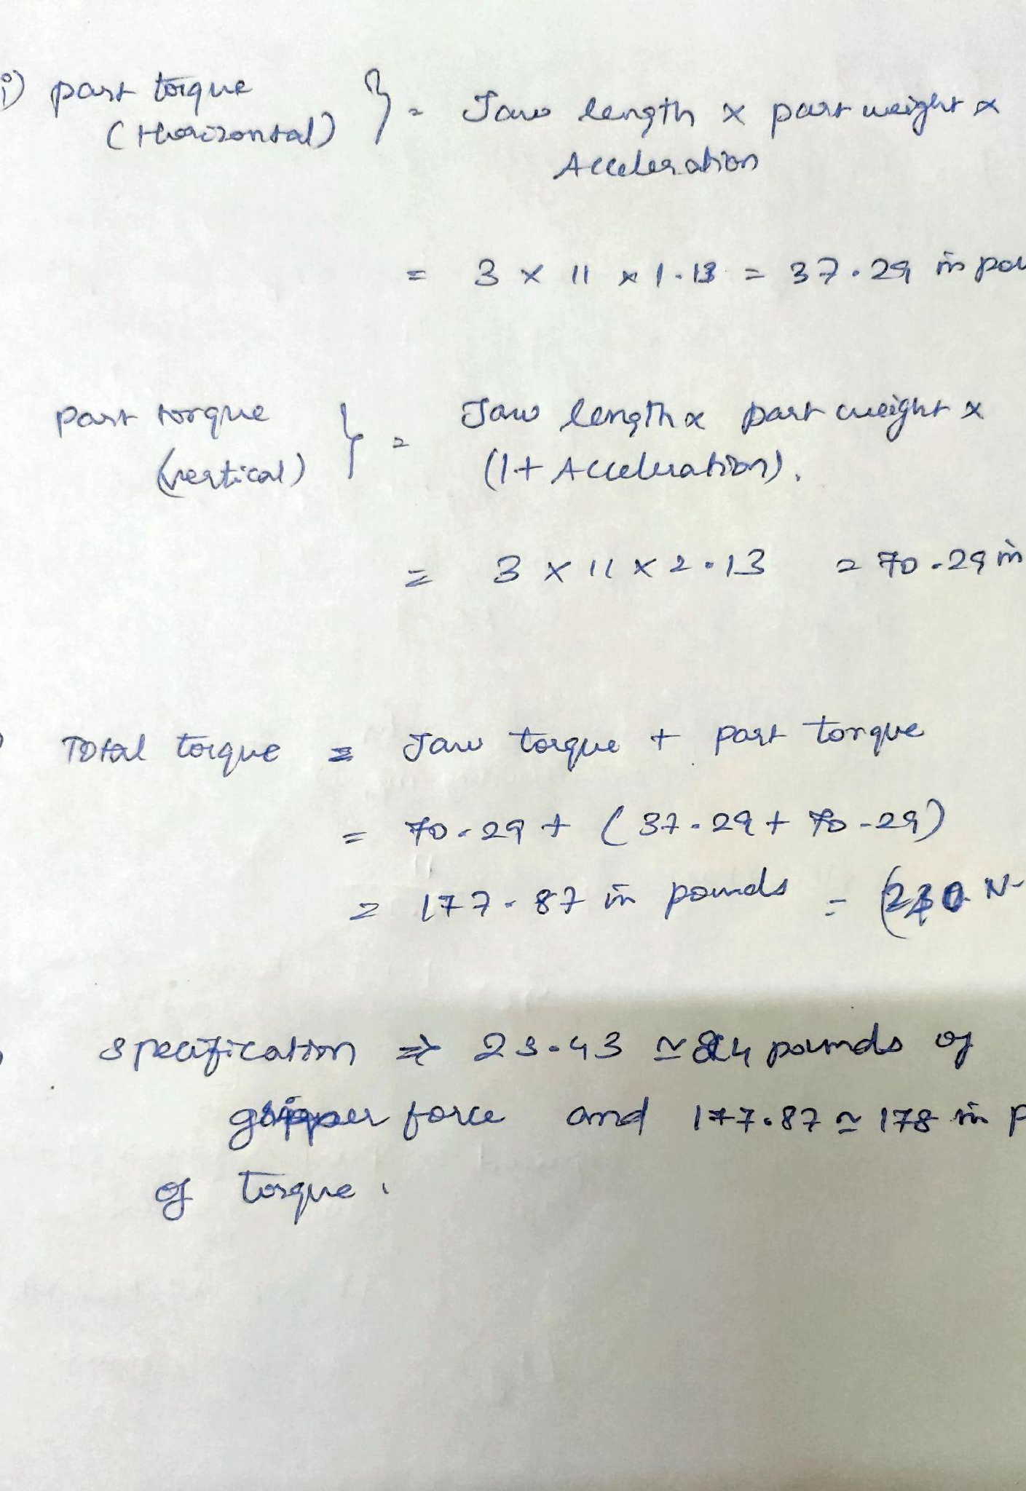

Slide 20
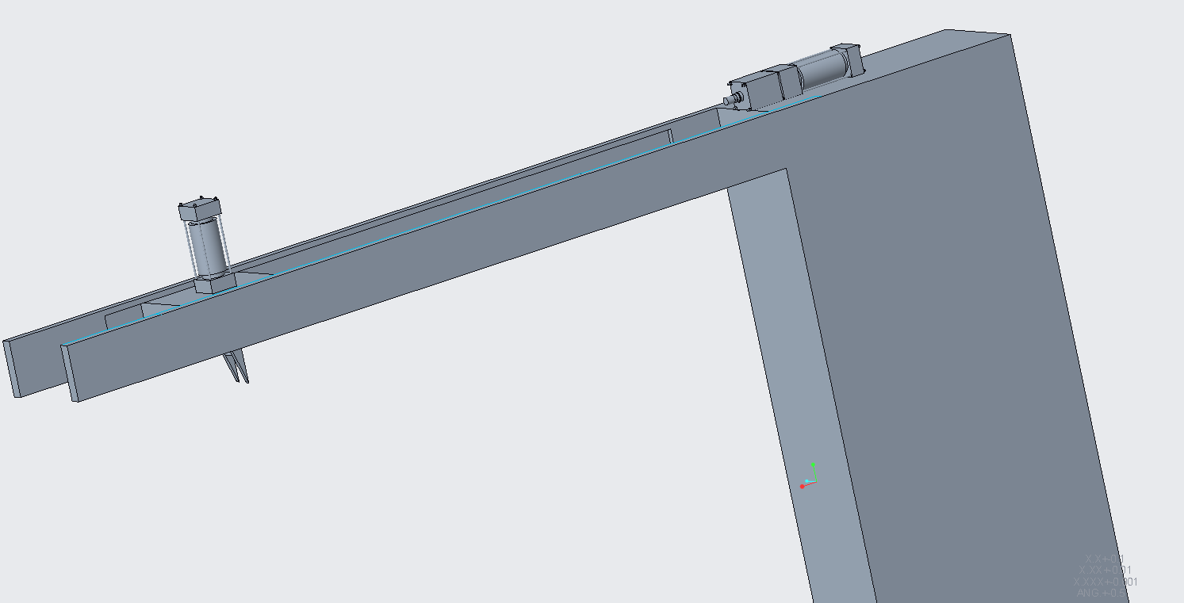
ISOMETRIC VIEW
.

Slide 21
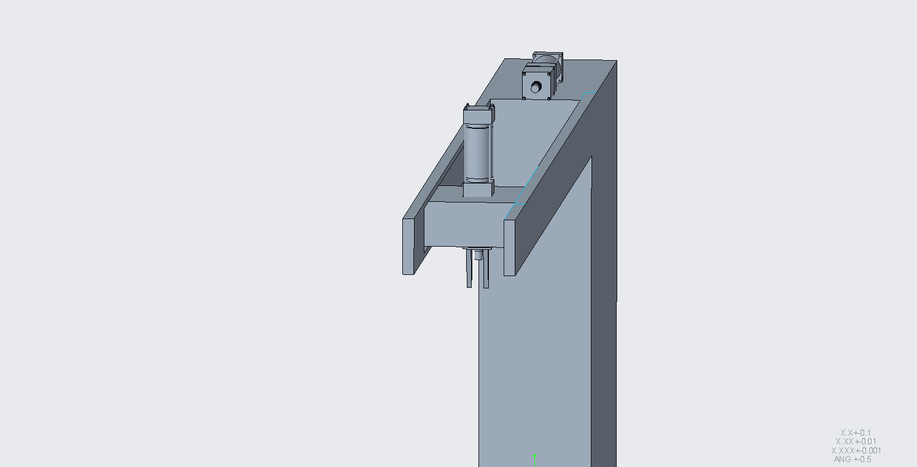
ISOMETRIC VIEW
.

Slide 22
COST ESTIMATION
.
S.No | Materials | Quantity | Cost
1. | Mild steel | 123kg | 61,000 (approx.)
2. | Actuator | 2 | 30000 (approx.)
3. | Gripper | 1 | 3000 (approx.)
4. | Motor | 1 | 10000 (approx.)
TOTAL = 104,000 (approx.)

Slide 23
CONCLUSION
Gantry Loader for Milling Machine utilizes the combination of control systems with end effectors and precise dimensional properties of parts to transfer the work piece from pick-up location, till it unloads at the work table. Among various approachable solutions, we have selected a concept that emphasizes the minimal cost cutting factor along with reasonable automation in the work environment.

Slide 24
THANK YOU

